Slide 1
Use Version Control
Github repositories
Everyone working from the same set of files
No emails with big files attached
If you use a common system, workflows are much easier to navigate!
You can have private & public repos
Github is GDPR compliant!
Notes:
TO DO
Find out the R experts & make sure they are present!
Make sure everything installed – Github desktop, R , Rstudio
Follow links that Elaine sent to connect (step 3 on desktop)
Make sure people open Github_demo.proj
Install packages too!

Slide 2
Getting started with GitHub
Make sure your Rstudio is linked with R and both are up-to-date
Create a GitHub account https://docs.github.com
Install GitHub Desktop
https://docs.github.com/en/desktop/installing-and-authenticating-to-github-desktop/installing-github-desktop
Link GitHub Desktop to your Github Account

Slide 3
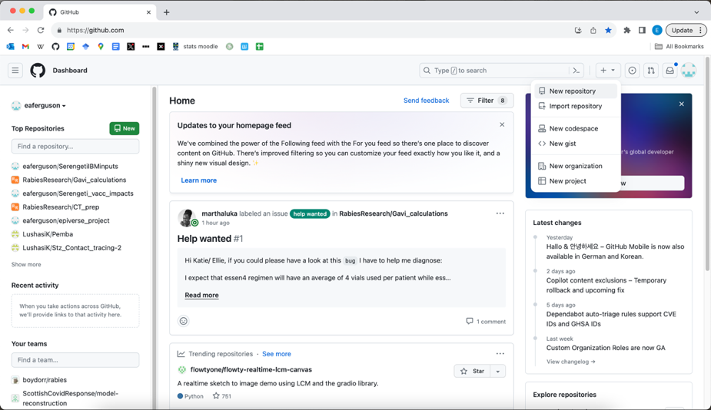
Creating a repository

Slide 4
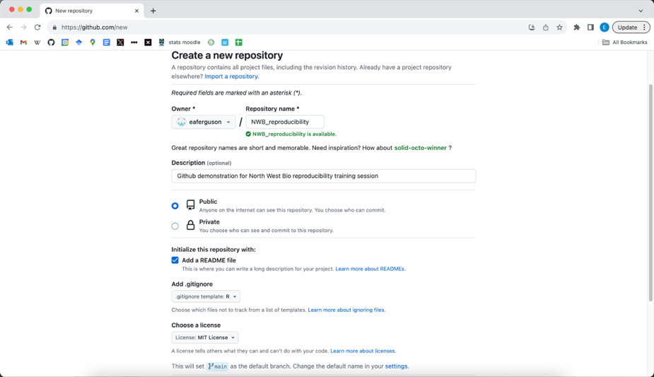
Creating a repository

Slide 5
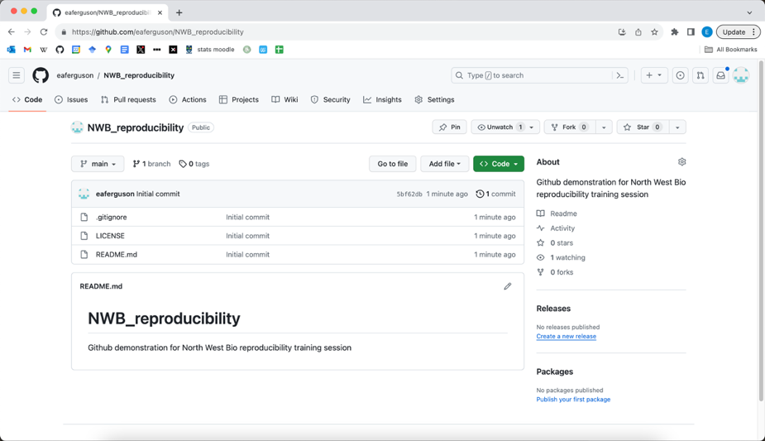
Creating a repository

Slide 6
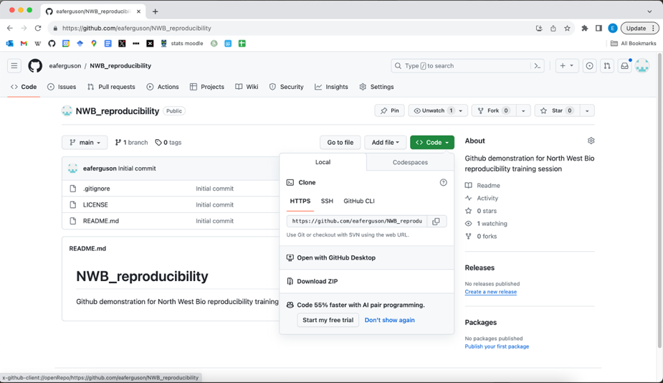
Clone repository using GitHub desktop

Slide 7
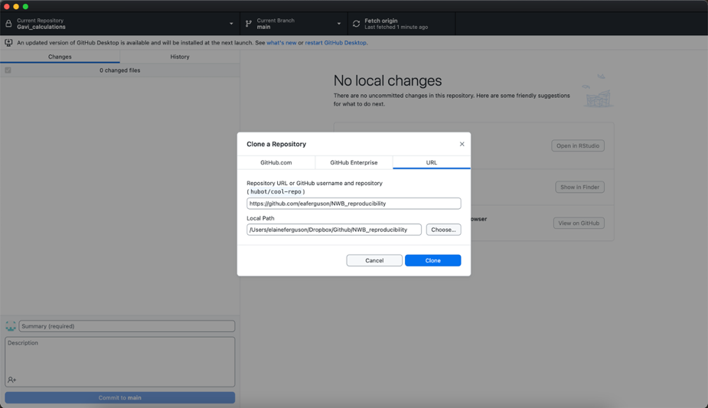
Clone repository using GitHub desktop
Repo URL
Local folder

Slide 8
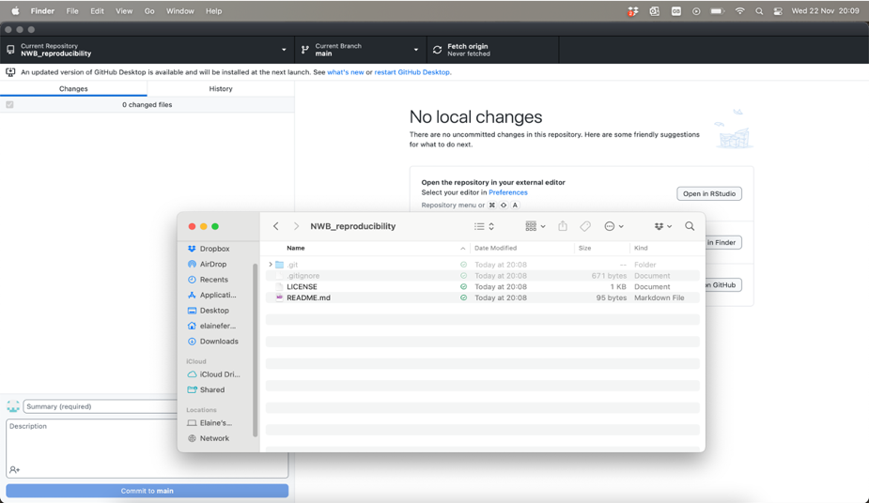
Clone repository using GitHub desktop

Slide 9
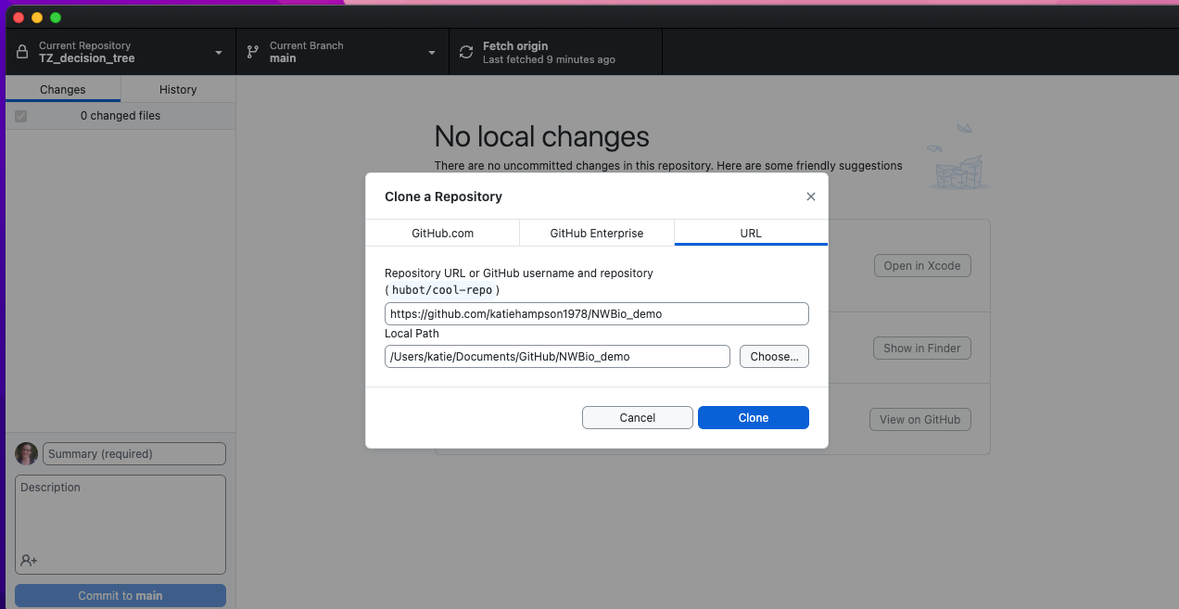
Now try to clone my repo!

Slide 10
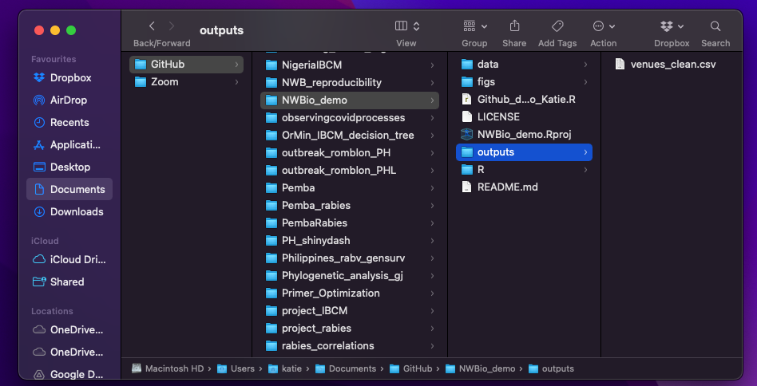
The saved code and outputs

Slide 11
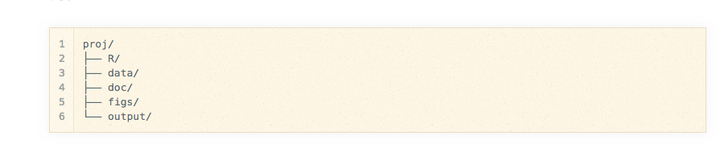
Note there is a system to help work effectively:
Keep raw data in data folder. Do not edit!
Archive older data (& code) just in case

Slide 12
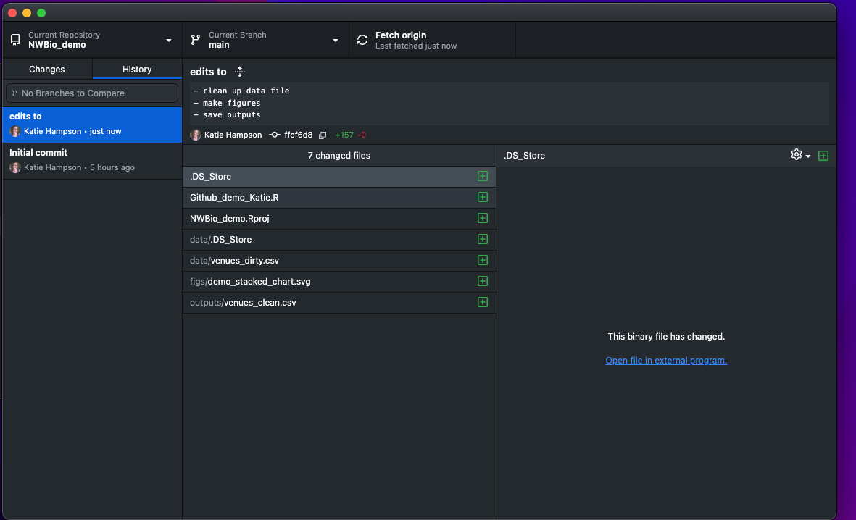
Updated via Github

Slide 13
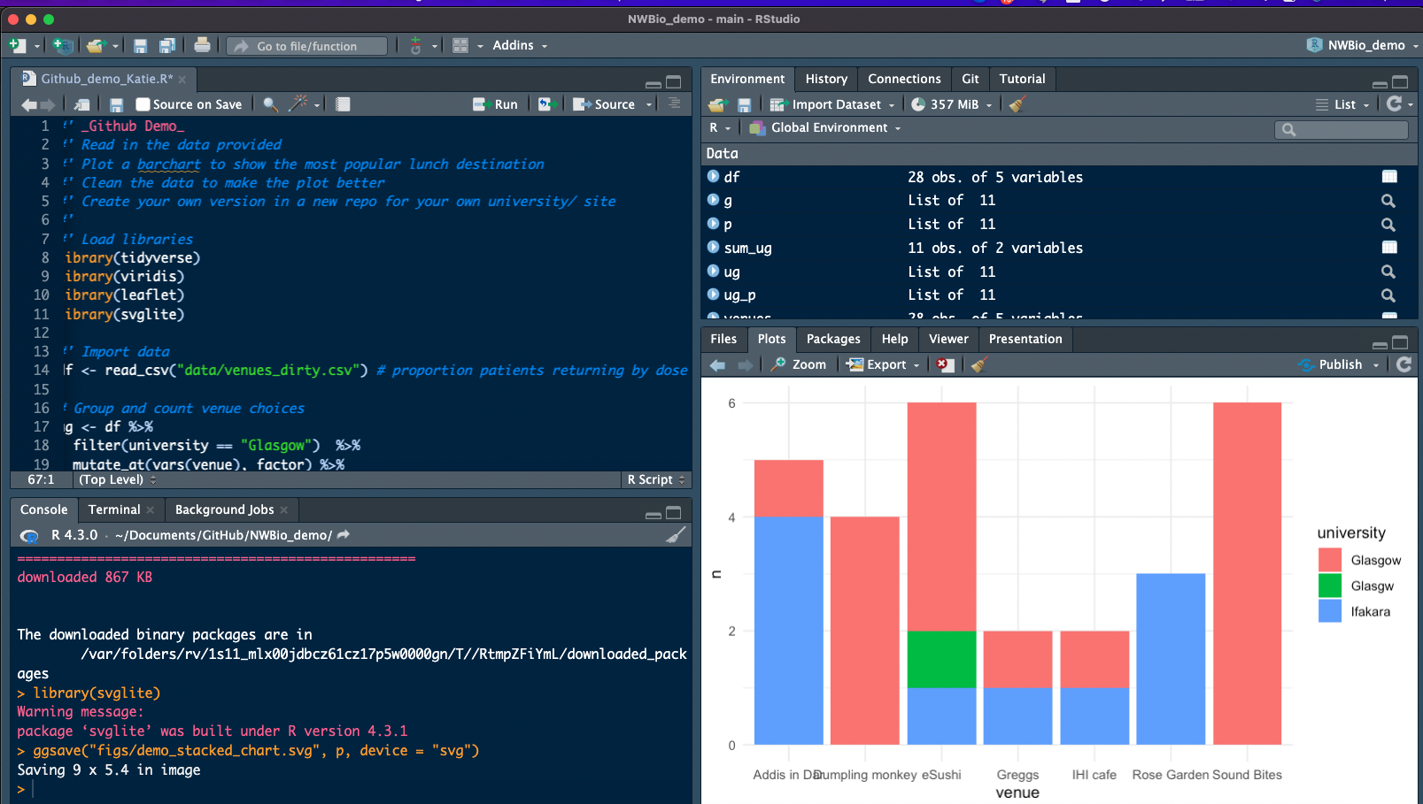
The code

Slide 14
Also note some basic good practice (project management)
Provide a README!
Use a clear folder structure
Create an Rproj
Save outputs e.g. saveRDS
Use informative file & folder names
Separate raw data from processed data

Slide 15
Can you run the code?
What is saved and where?
What needs fixing?
Can you fix these things?
Check with your remote colleague whether your fixes work via Github!

Slide 16
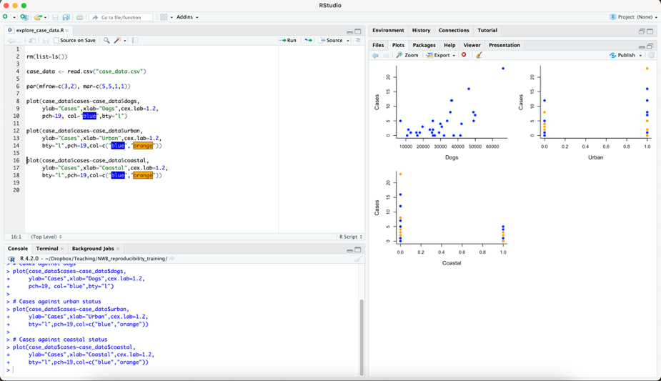
Add some R code and data

Slide 17
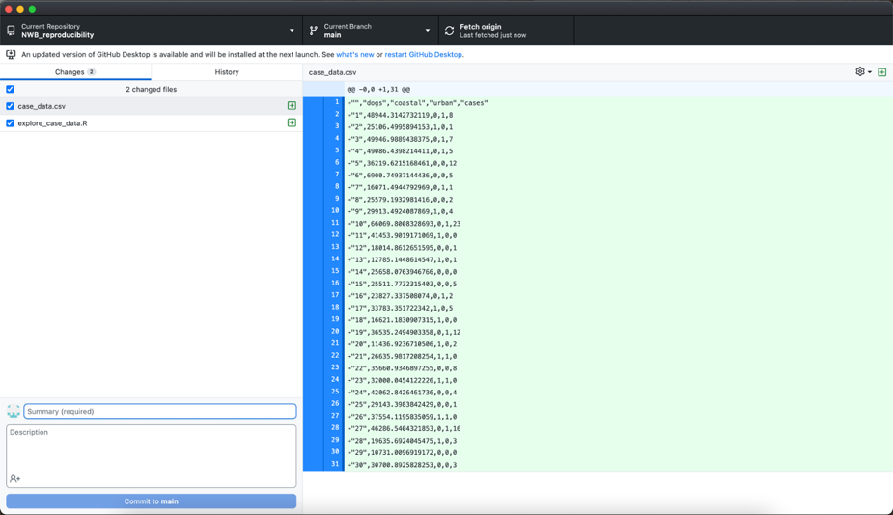
Add some R code and data

Slide 18
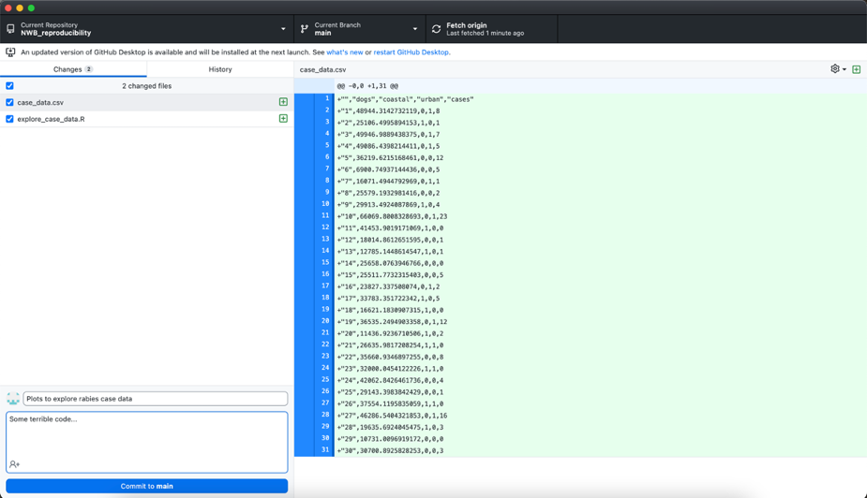
Commit the changes locally

Slide 19
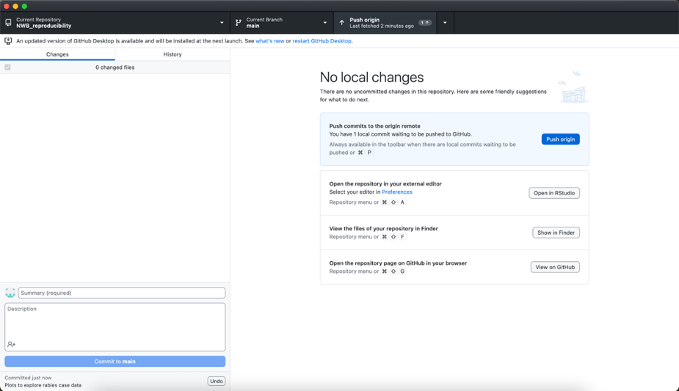
Push the changes to GitHub

Slide 20
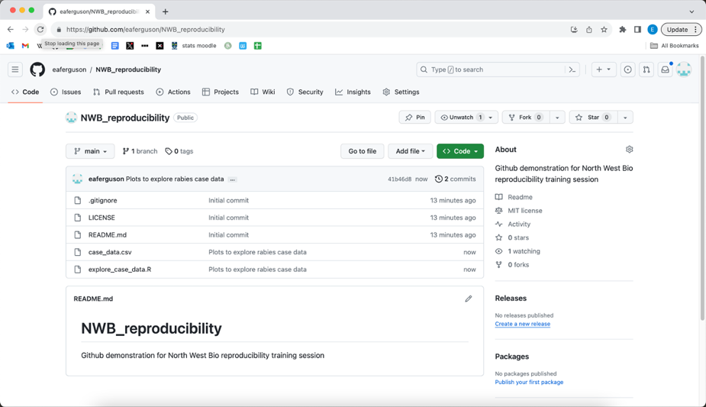
Push the changes to GitHub

Slide 21
Can you make your own repo & share with your remote collaborators?
Create your own repo adapted from the demo
Invite collaborators
Work out your own (local) venue preferences
Use Github issues to request changes from your collaborators
Share the revised update repo with another group

Slide 22
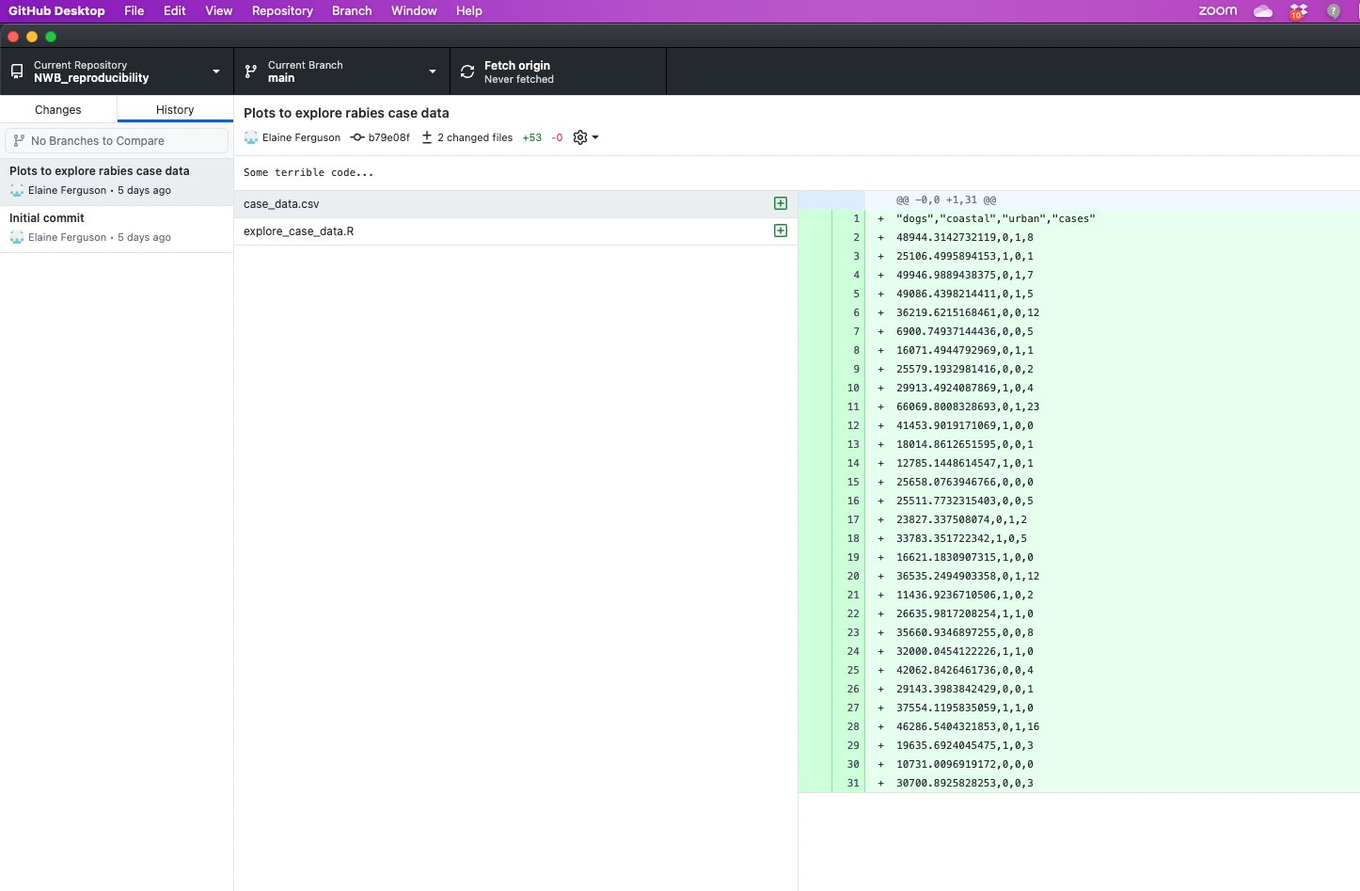
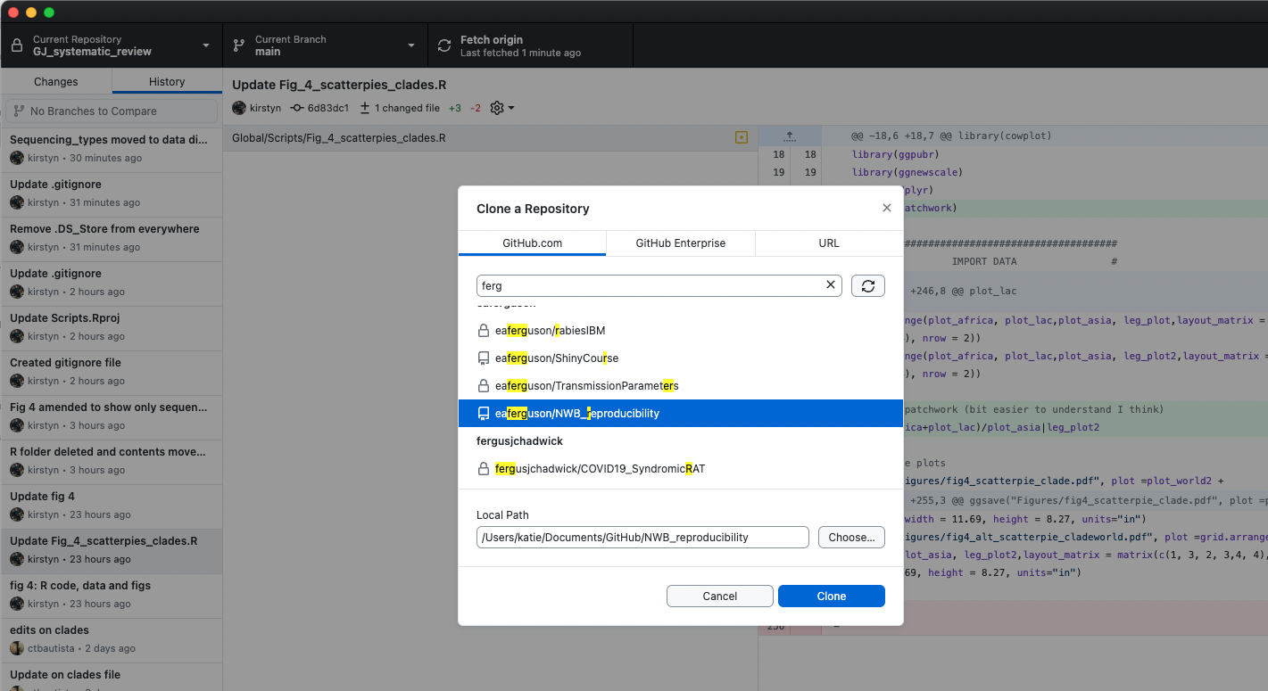
Collaborator accepted invite & cloned repo

Slide 23
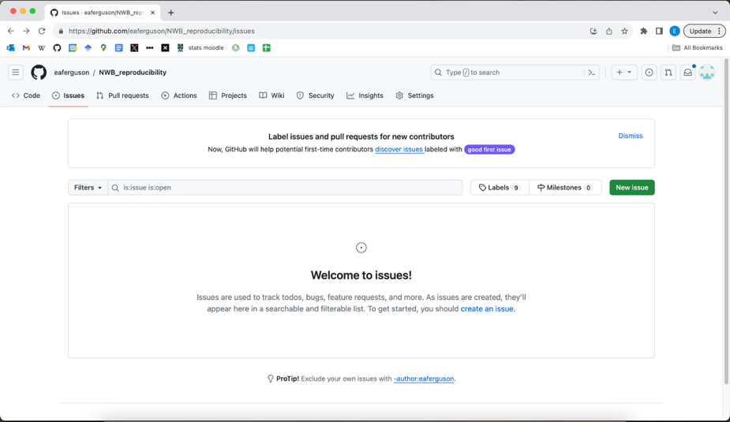
GitHub issues

Slide 24
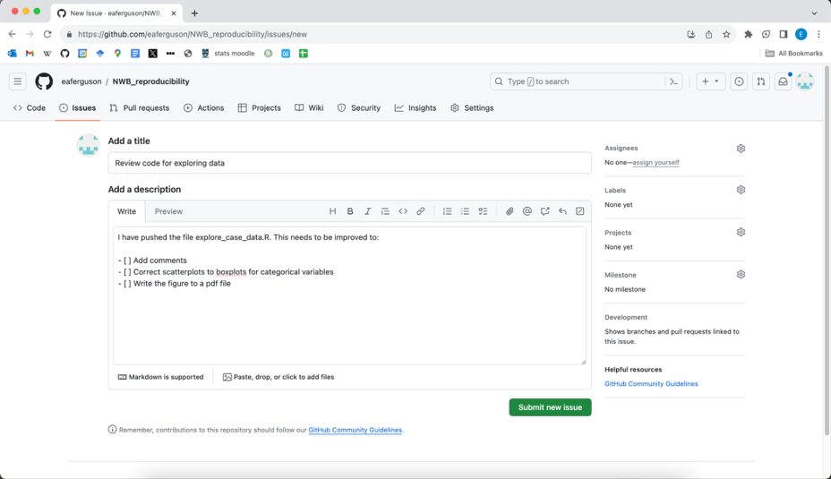
Creating an issue

Slide 25
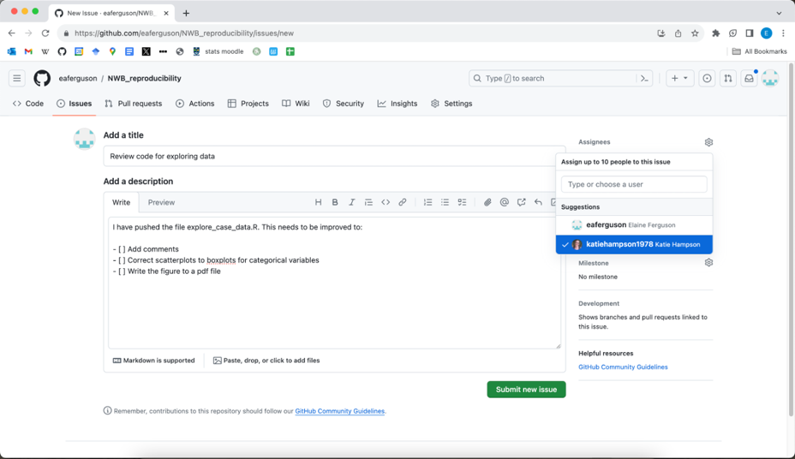
Creating an issue: Assigning

Slide 26
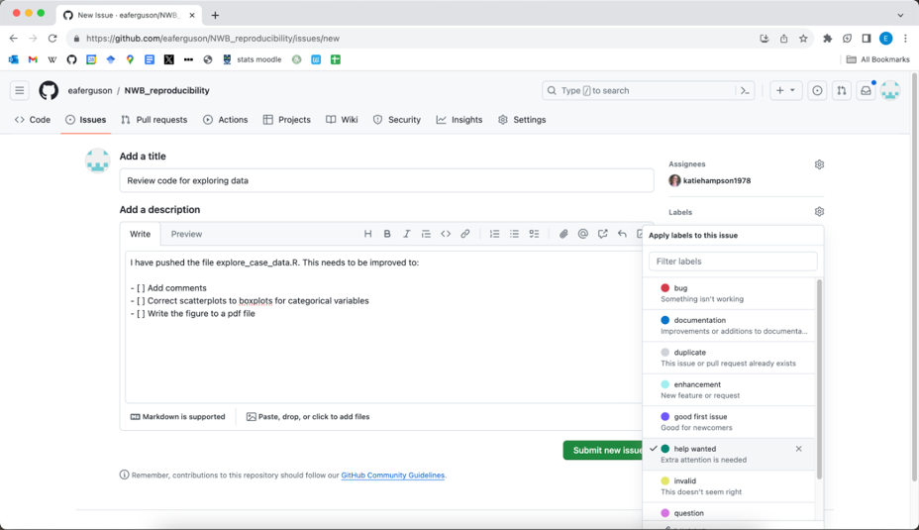
Creating an issue: Labels

Slide 27
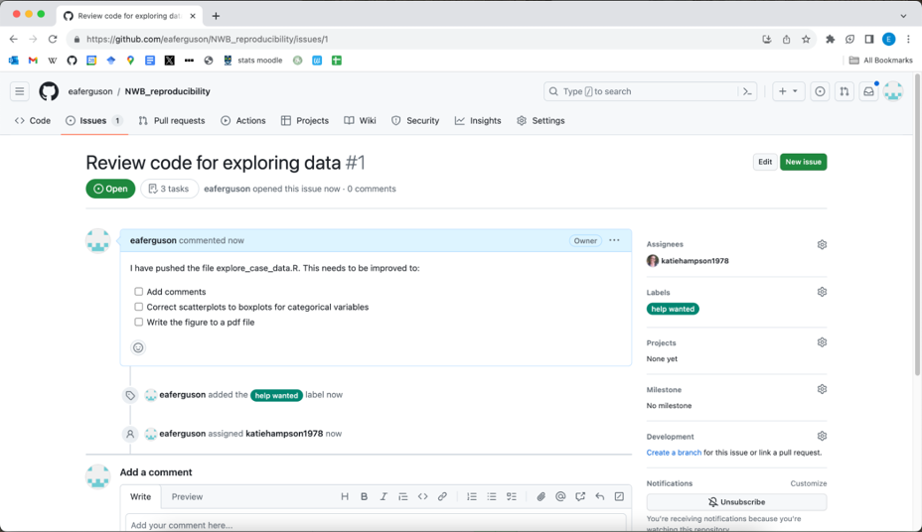
Creating an issue

Slide 28
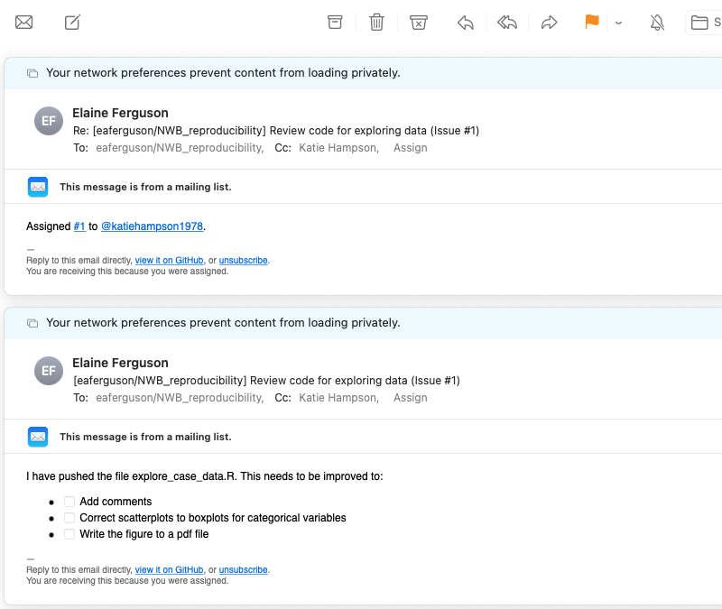
Collaborator receives issue notification

Slide 29
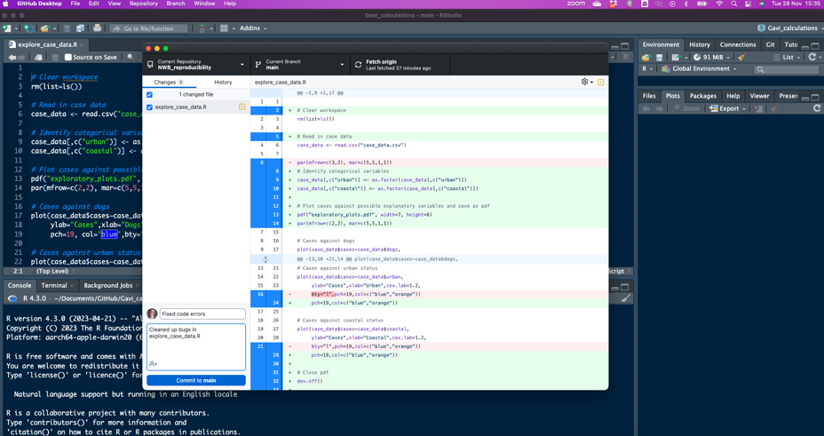
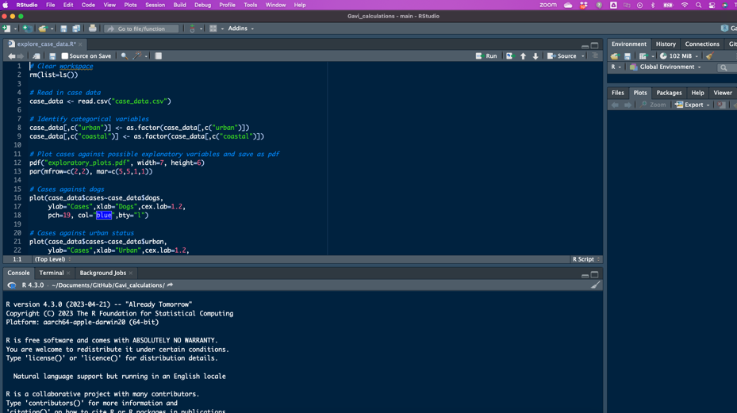
Collaborator corrects some errors in the code
& pushes correction back to repo

Slide 30
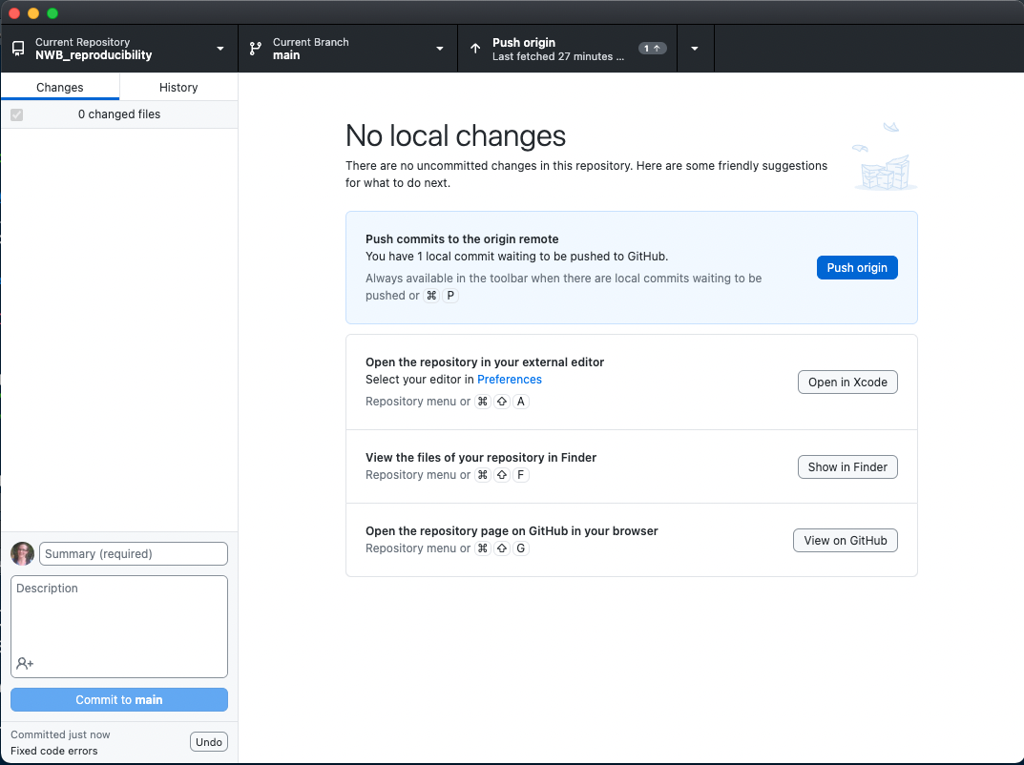
Collaborator corrects some errors in the code
& pushes correction back to repo

Slide 31
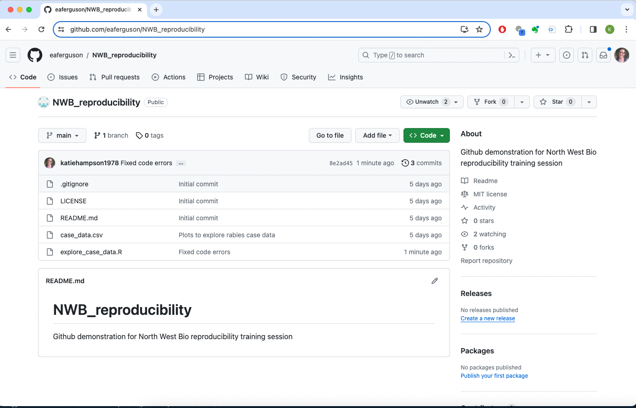
All changes now on the repo
Notes:
And the animation is to make Elaine laugh at my horrific open tab addiction......

Slide 32
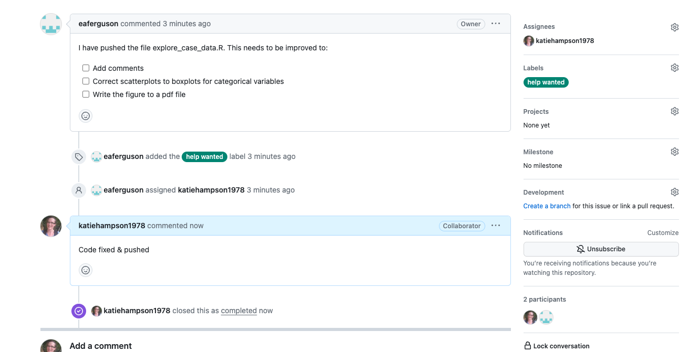
Collaborator closes the issue

Slide 33
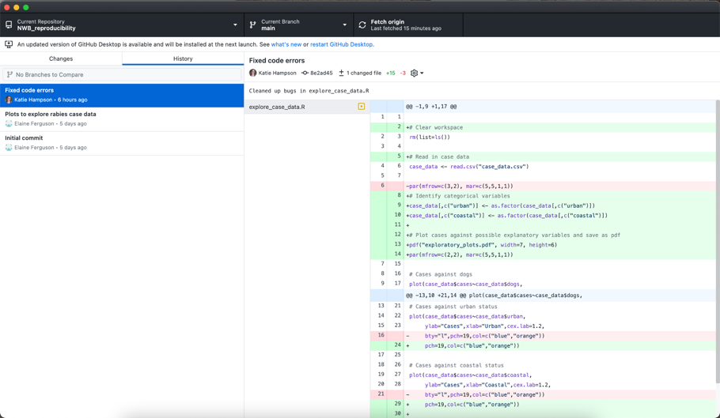
Pull code correction from GitHub to local repo

Slide 34
Did the venue preference barchart work?
6
4
university
n
Glasgow
Ifakara
2
ARGH?
0
Addis in Dar
Dumpling monkey
eSushi
Greggs
IHI cafe
Rose Garden
Sound Bites
venue
Glasgw

Slide 35
Did the venue preference barchart work?
6
4
university
n
Glasgow
Ifakara
2
0
Addis in
Dar
Dumpling
monkey
eSushi
Greggs
IHI cafe
Rose
Garden
Sound
Bites
venue

Slide 36
6
4
university
Glasgow
n
Glasgw
Ifakara
2
0
Dumpling monkey
eSushi
Greggs
IHI cafe
Sound Bites
venue
Addis in Dar
Rose Garden

